Slide 1
SugarSpice Makers
PIONEERS CONSULTING COMPANY
PROJECT MEMBERS:
RIDHI TATINENI
LAUKIK GAIKWAD
MALVIKA DAGDU

Slide 2
Background

Slide 3

Who we are
Project Pioneers is a Project Management company specializing in food industry.
Our previous clients:
-Concu Bakery
- Mamoun’s Falafel
- Cafe Au Lait
Notes:
•Something about the client and consulting firm.
•Who the client are??their back ground/high level of what their business and why they are starting the restaurant business.
•Consulting firm – type of service rendered/ experience/who are our customer base.

Slide 4
The Client
A group of new graduate students who want to open a restaurant in a bustling part of New Brunswick.
These students have a graduate degree in Master of Business and Science with a concentration in Food Science.
First startup with no previous experience
Looking for project management consultants to drive their project

Slide 5
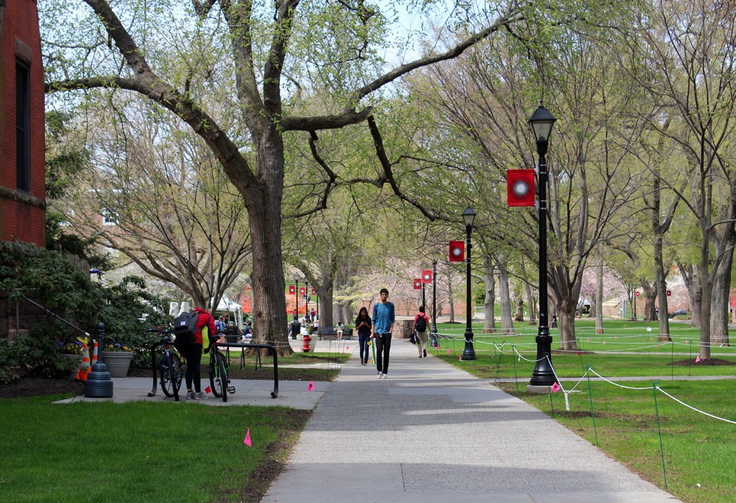
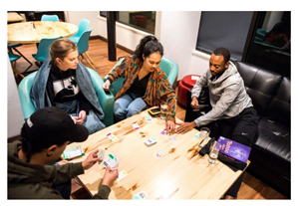
Project ‘SugarSpice Makers’
Project Start Date: 6/12/2018 Project End Date: 12/12/2018
Need: A refreshing space for people to come and de-stress themselves in a fun area
Stakeholders:
Mr. George McGuire
Ms. Nicole Murphy
Mr. Peter Parker
Location:
61 George Street, New Brunswick, NJ 08901
Notes:
RIDHI
What they were looking for??
Change the title - something as a first point of discussion

Slide 6
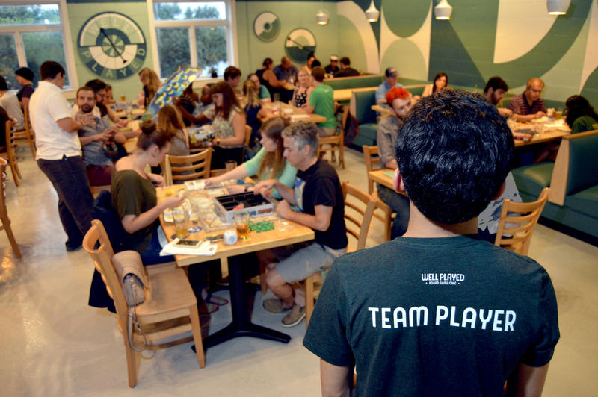
Target group : Opening a bistro for young adults
Description:
Bistro with board games and table games such as table tennis, foosball
Continental cuisine, pastries and gelato
A library with novels, journals, magazines and newspapers
encouraging “face-to-face fun”
An interactive space with good music
Seats 60-70 customers with tables that seat parties of 2, 4, 6 and 10
No free Wi-Fi to encourage “face-time” with friends and “me-time”
How will the business be successful?
Good discounts for students, coupons, weekly interactive game specials and dance events, live music
Notes:
RIDHi
Business plan - what they want to achieve and how

Slide 7
Agenda
Project Scope
Project Requirement Collection
Project Planning
Project Execution
Project Closure
Notes:
RIDHI

Slide 8
Project Scope
Notes:
ARYA

Slide 9
Project Objective
To open a new restaurant within 6 months with a budget of $1 million based on top-down approach.
Notes:
ARYA

Slide 10
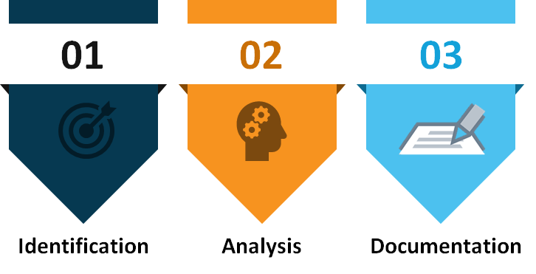
Requirement Collection stage
Notes:
ARYA

Slide 11
Deliverables
1. Final menu for the concept
2. Costing of the menu items
3. Leased space for opening the restaurant (site planning)
4. Designing the interiors and exteriors of the restaurant
5. Finding a food supplier
6. Procurement of furniture for the seating area (eg. tables, chairs, paintings) by placing bulk order with merchant
7. Procurement of kitchen equipment and bulk order of crockery, cutlery, sides and sauces etc.
8. Recruiting HR team - consisting of all staff (eg. servers, kitchen staff, delivery staff, cashier etc.) starting out with a Manager.
9. Installation and maintenance of equipment until restaurant opening
10. Licensing - safety, hygiene
11. A marketing plan to attract customers for the grand inauguration day
12. Restaurant Inauguration
Notes:
ARYA:
Mention that we made the client accept these deliverables as a method of achieving scope control

Slide 12
Milestones
Finding the location for the restaurant
Acquiring the contract of a physical space
Getting done with the interiors
Recruitment of all staff
Setting up the kitchen
Finalizing the menu
Setting up the seating area
Passing the food inspection
Restaurant Inauguration Day
Notes:
ARYA

Slide 13
Assumptions
Renovation of space will be completed by December 10th 2018
Project will finish in budget and will meet safety regulations
Project will be completed by 12th December 2018 by ending with the Inauguration event
Constraints
Time limit
Notes:
ARYA

Slide 14
Project Requirement Collection
Notes:
LAUKIK

Slide 15


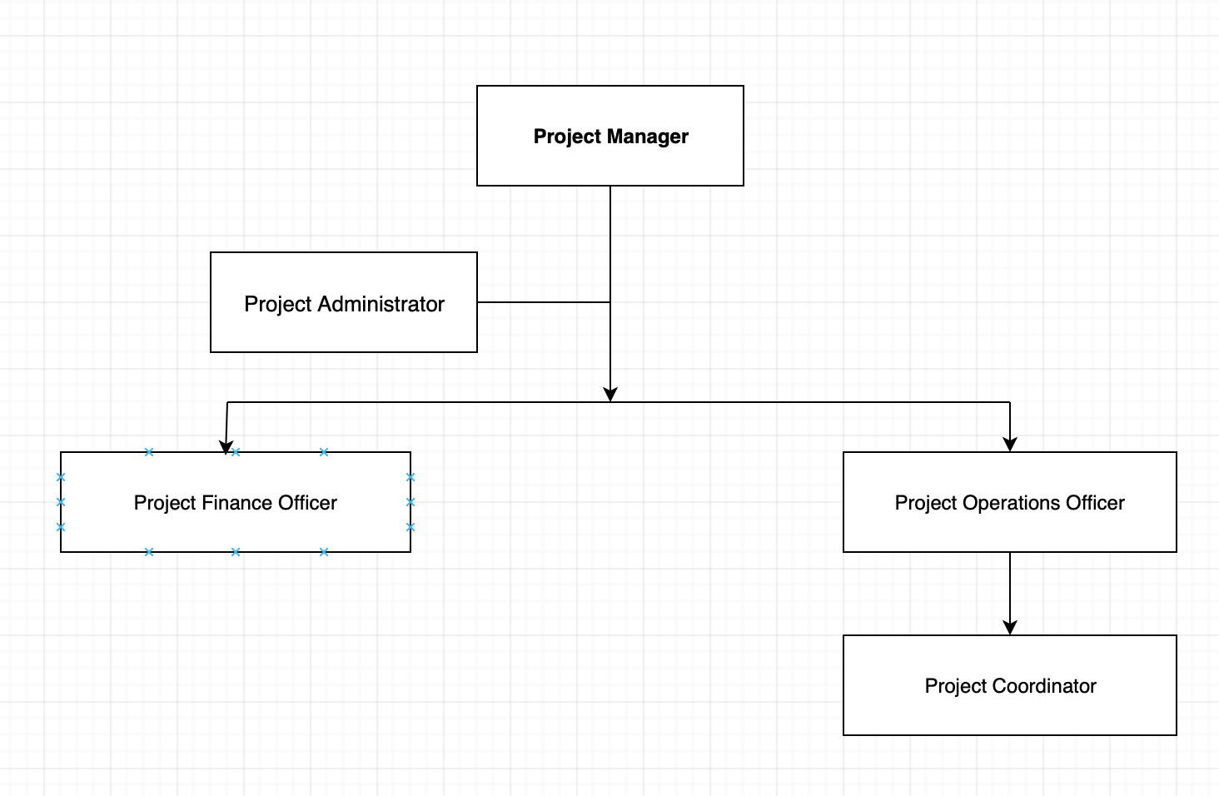



Project Team Structure
Notes:
LAUKIK

Slide 16
The Hierarchy
Project Manager: Responsible for gathering project requirement for all phases, creating clear and attainable project objectives, building the project requirements and managing the quadruple constraints of the project management, which are cost, time, scope and quality. Controls the change of the entire project by initiating and implementing a change request.
Project Finance officer: Reports individual and project status. Performs all project activities as needed. Develops project budget requirements.
Notes:
ARYA

Slide 17
The Hierarchy
Project Operations officer: The project operations officer’s responsibilities are to ensure compliance with insurance, legal, health and safety obligations. The officer will specify staff requirements and coordinate their activities, cooperate, ensure transportation and equipment control. Basically handle any emerging problems
Project Coordinator: Ensures on time delivery of materials. Reports individual and project status to PM. Performs all project activities as needed.
Project Administrator: Performs all project activities as needed. Coordinates and schedules all internal and external project meetings. Assists Budget and Finance Officer with payments, invoices etc.
Notes:
ARYA

Slide 18
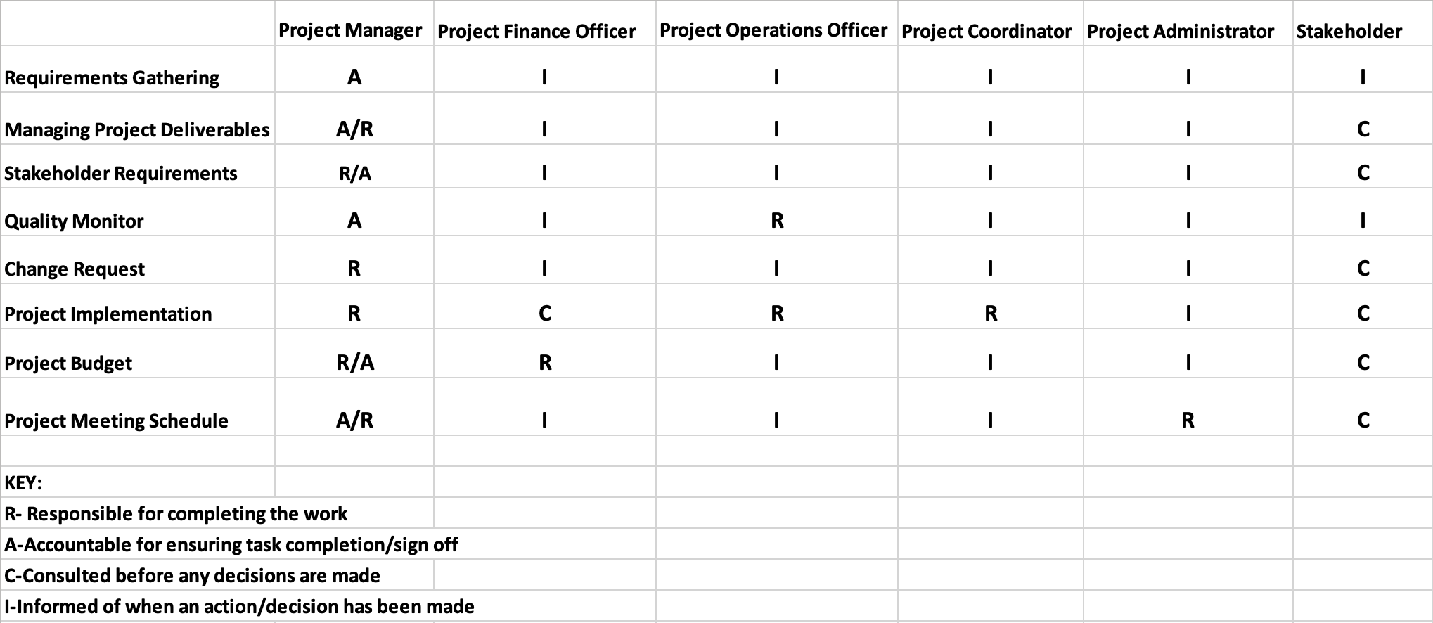
RACI chart
Notes:
LAUKIK

Slide 19
Project Planning
Work Breakdown Structure
Cost Management
Resource Availability Plan
Notes:
MALVIKA

Slide 20
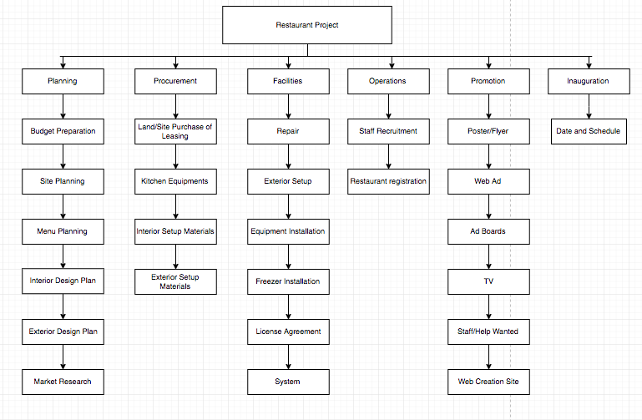
Work Breakdown Structure
Notes:
MALVIKA

Slide 21
Cost Management
Cost is an important factor while working on our project. Hence, managing our costs is a crucial task.
Therefore, these are the costs that would be necessary to open up a restaurant.
i) Furniture (chair, tables) - $ 100,0000
ii) Equipments (mixer, grinder, refrigerator, etc.) - $150,000
iii) Human Resources - $100,000
iv) Transportation of food requiring vans, bikes for home delivery - $100,000
v) Food materials comprising grocery - $50,000
vi) Renting space $350,000
vii) Designing the restaurant $100,000
viii) Advertisement - $50,000
Notes:
MALVIKA

Slide 22
Overhead Costs
There are many costs that are not directly linked to the project. These costs are the Overhead costs, which include advertising, accounting.
Direct Costs : $550,000
Direct Overhead : $100,000
Total Direct : $650,000
G&A overhead : $200,000
Total Cost: $850,000
Profit (20)% :$170,000
Total Bid : $1,000,000
Notes:
MALVIKA
By apportion method, just write the cost below the WBS. ,
Apportion Methods: This method is an extension to the ratio method. Apportionment is used when projects closely follow past projects in features and costs. Given good historical data, estimates can be made quickly with little effort and reasonable accuracy. This method is very common in projects that are relatively standard but have some small variation or customization

Slide 23
Cost Management
The cost plan summarizes using a top-down approach method for all the space, designing,food,advertisement,equipment to fulfill the demands of the client and opening the restaurant SugarSpice.
The project baseline is $1 million.
We are using APPORTION METHOD
Notes:
MALVIKA

Slide 24
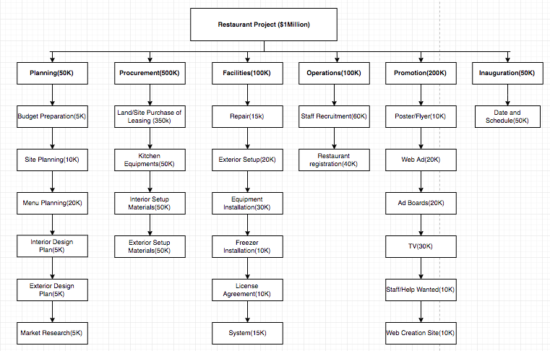
Cost Breakdown Structure

Slide 25
Resource Availability Plan
Notes:
JHANANI

Slide 26
NETWORK DIAGRAM
C
A B E F
D
Dependencies
Burst
Convergence
A | Planning
B | Procurement
C | Operations
D | Facilities
E | Promotions
F | Inauguration
Parallel

Slide 27
NETWORK DIAGRAM
0 | A | 12
0
0 |  | 12
12 | B | 48
0
12 |  | 48
48 | C | 84
48
96 |  | 132
132 | E | 168
0
132 |  | 168
168 | F | 180
0
168 |  | 180
A | Planning
B | Procurement
C | Operations
D | Facilities
E | Promotions
F | Inauguration
48 | D | 132
0
48 |  | 132

Slide 28
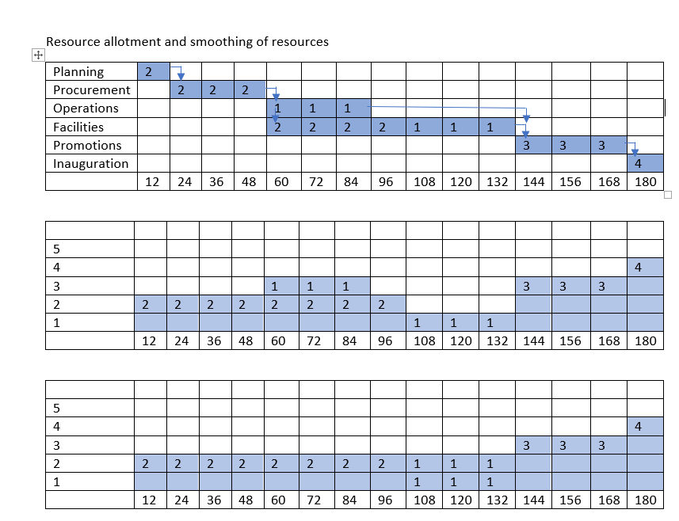
Notes:
JHANANI

Slide 29
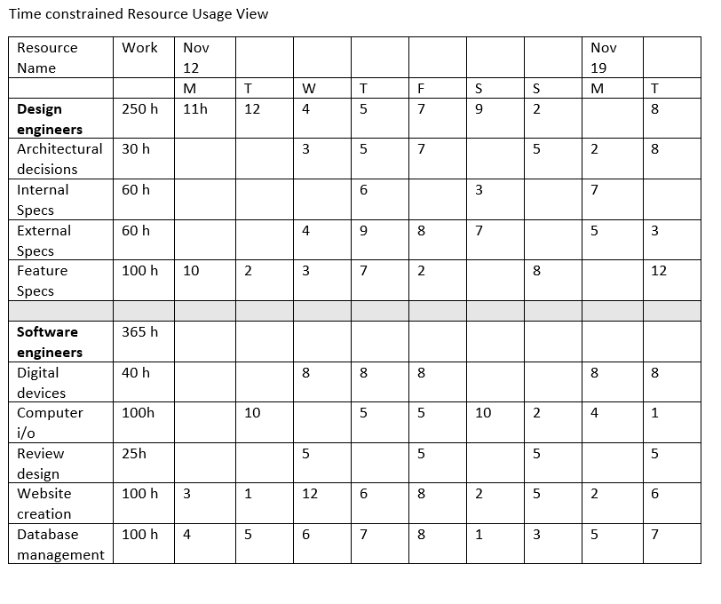
Notes:
JHANANI

Slide 30
Staff Performance management - Conflict management
Forcing
Collaborating
Behavior Focused On self
Compromising
Withdrawing
Smoothing
Behavior that focused on others
Notes:
JHANANI
Appraisals and feedback
Issue log

Slide 31
Risk Management
Notes:
RIDHI

Slide 32
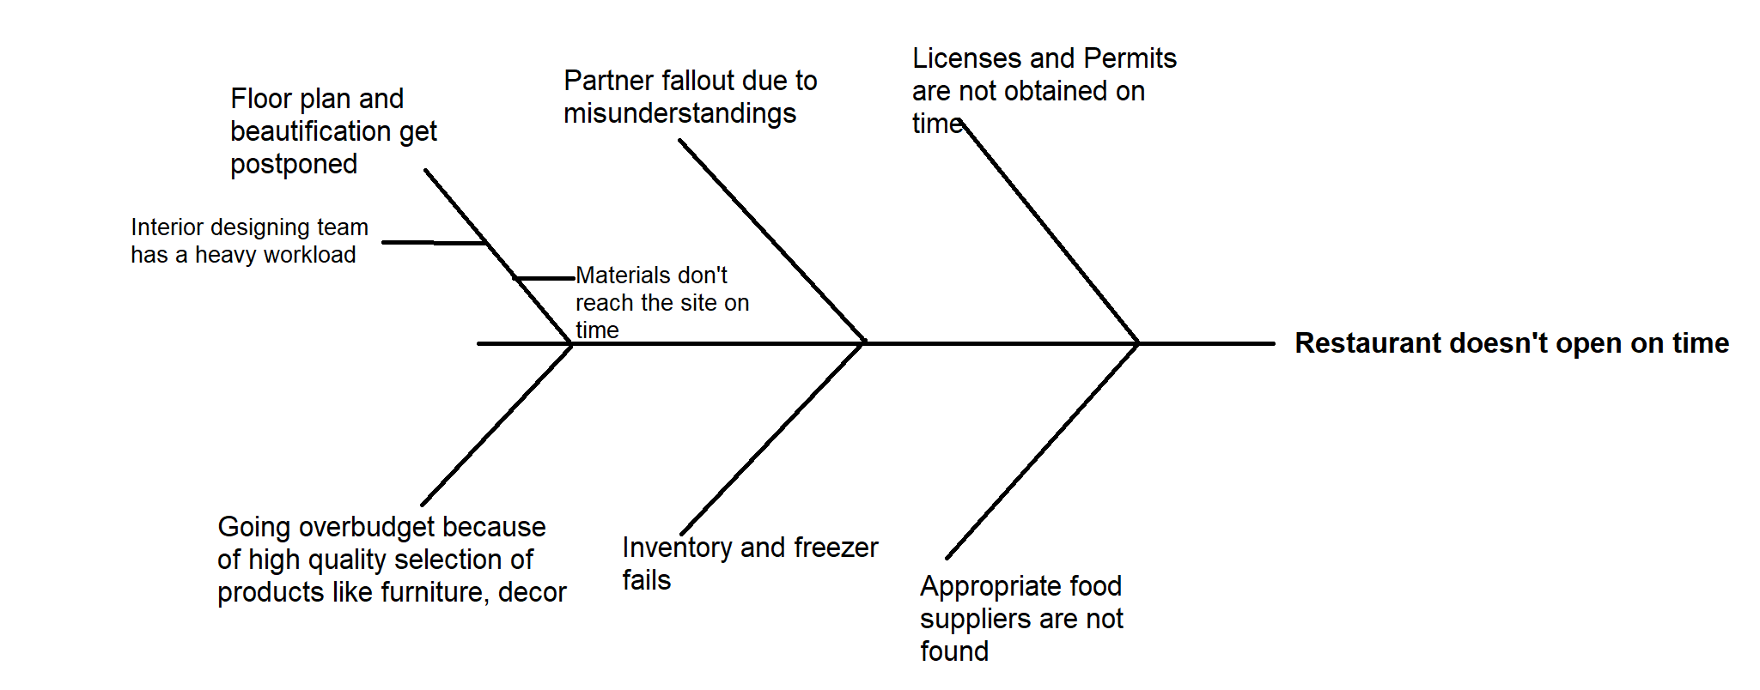
Possible problems before Restaurant launch
Notes:
RIDHI
Failure Mode Effective Analysis

Slide 33
FMEA Quantitative Risk Management
Risk Description | Probability | Impact | Priority | Response
Fire and property damage | 3 | 5 | 5 | AVOID: Weekly check and staff training on smoke alarms, how to use fire extinguishers MITIGATE: getting insurance.
Suppliers change terms and conditions | 3 | 3 | 3 | PREVENT: Establish good relationship with suppliers
Hygiene Standards that might lead to food poisoning | 3 | 5 | 5 | PREVENT: Good quality ingredients by keeping a tab on expiry dates
Notes:
RIDHI
Failure Mode Effective Analysis

Slide 34
Quantitative Risk Management
Risk Description | Probability | Impact | Priority | Response
Suppliers do not fulfil responsibilities (supplying items on time) | 1 | 3 | 3 | PREVENT: Have a backup list of suppliers and replacement products
Rental disputes | 1 | 3 | 5 | PREVENT: Develop good relationships with landlord
Key staff resigns or takes sick leave | 1 | 3 | 3 | MITIGATE: Training for all staff so that they can fill in for those that leave
Notes:
RIDHI
Failure Mode Effective Analysis

Slide 35
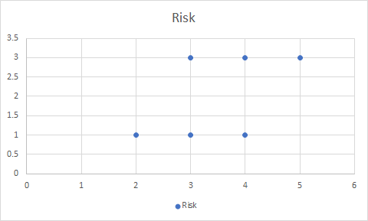
Qualitative analysis
Probability
Impact

Slide 36
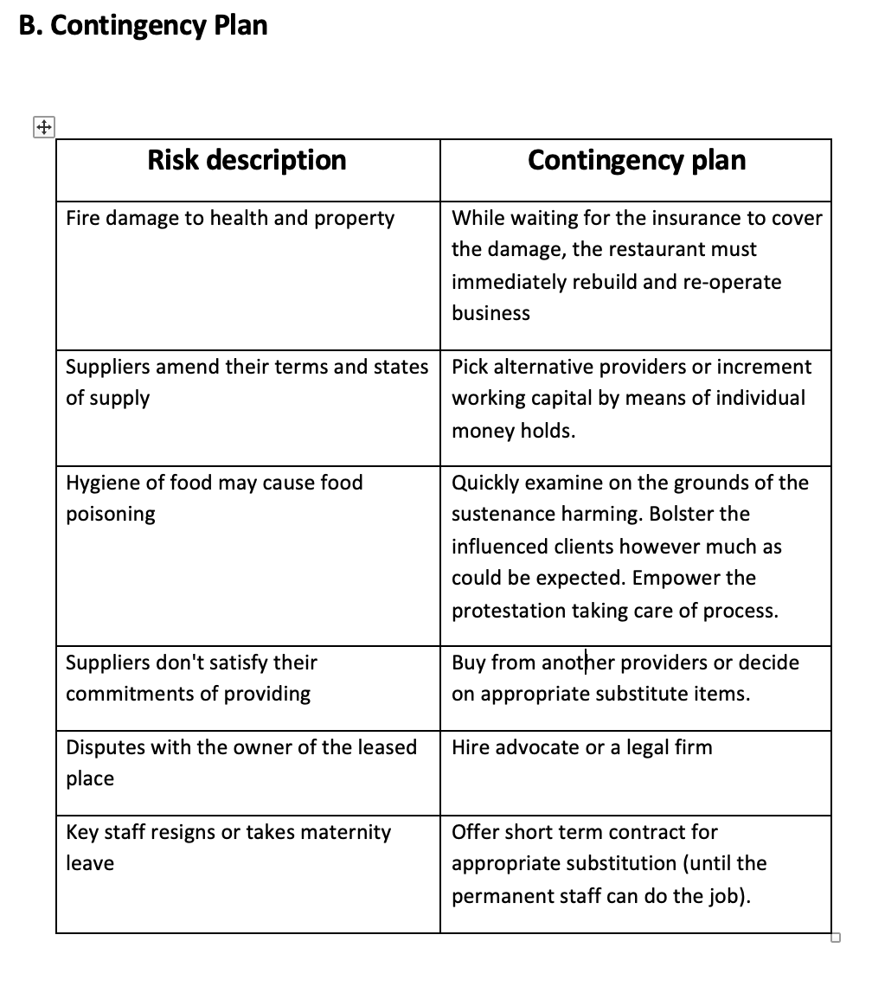
Notes:
RIDHI

Slide 37
Stakeholder Communication
POSITION AND ROLE | COMMUNICATION TYPE | COMMUNICATION REQUIREMENTS | INTERNAL/ EXTERNAL | INTEREST LEVEL
Project Sponsors and Owners of Bistro | Weekly progress reports, Document/Plan revisions, Document/ Plan approvals/rejection, Project Plan approvals/ rejection, Project Deliverable order/receipt reports, Lessons Learned | To be provided with all reports, plans, revisions, project documents, and deliverables in accordance with the WBS and Project Schedule | External | High
Project Manager | Weekly progress reports, Document/Plan revisions, Document/ Plan approvals/rejection, Project Plan approvals/ rejection, Project Deliverable order/receipt reports, Lessons Learned | To prepare the Project Schedule and to be provided with and provide the Project Manager with all reports, plans, revisions, project documents, and deliverables in accordance with the WBS and Project Schedule | Internal | High
Project Finance Officer | Project Budget, Weekly progress reports, Document/Plan revisions, Document/ Plan approvals/rejection, Project Plan approvals/ rejection, Project Deliverable order/receipt reports, Lessons Learned | To prepare the Project Budget and to be provided with and provide the Project Manager with all reports, plans, revisions, project documents, and deliverables in accordance with the WBS and Project Schedule | Internal | High
Notes:
TONY

Slide 38
POSITION AND ROLE | COMMUNICATION TYPE | COMMUNICATION REQUIREMENTS | INTERNAL/ EXTERNAL | INTEREST LEVEL
Event Operations Officer | Weekly progress reports, Document/Plan revisions, Project Deliverable order/receipt reports, Lessons Learned | To assist the Project Officers and Project Manager in the production of all reports, plans, revisions, project documents, and deliverables in accordance with the WBS and Project Schedule | Internal | High
Project Coordinator | NA | To assist the Project Officers and Project Manager in the production of all reports, plans, revisions, project documents, and deliverables in accordance with the WBS and Project Schedule | Internal | Medium
Notes:
TONY

Slide 39
Project Close-out Resource Release Report
Notes:
TONY

Slide 40
General Wrap Up
Found 61 George St. available and leased the place for $325,000 per year on Day 23
Finalized the menu on Day 47
Outsourced the interior plan for $87,000 and with the equipment and installation fee, the total cost is $340,000. The whole part finished on Day 110
Recruited all needed employees on Day 146 with the cost of $97,000
Found appropriate food supplier on Day150
Notes:
TONY

Slide 41
General Wrap Up (Continued)
Got all necessary licenses on Day 152 with the cost of $9,000
Finished the advertising of the restaurant on Day 166 with the cost of $67,000
The inauguration date is on Day 180
The total bill is $838,000.
The total time for this project is exact 6 months.

Slide 42
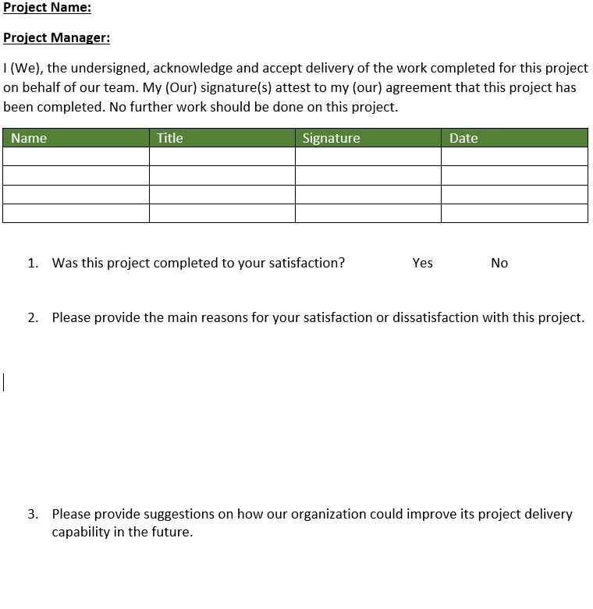
Project Completion Form

Slide 43
THANK YOU!

